Slide 1

Getting
Jay Smith
Tyson Foods, Inc.

Slide 2
About Me

Slide 3
Agenda
Centralized vs. Distributed Version Control
Basic Workflow
First Steps to using git
Installing mysisgit
Configuring
How to clone repositories
How to work with remote repositories
Notes:
Using git locally without a server
Using git with a remote server

Slide 4
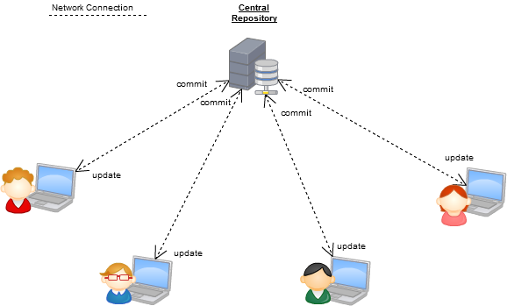
Centralized Version Control
Notes:
The typical setup of a centralized system such as CVS, Subversion and even Team Foundation Server involve a server with a repository and users as clients that push and pull the changes remotely. Everyone must be in tone with the same repository at the same time, if they want to commit.

Slide 5
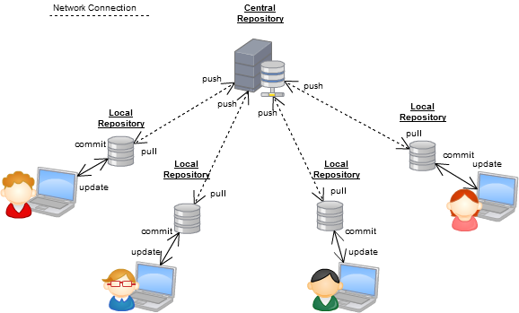
Distributed Version Control

Slide 6
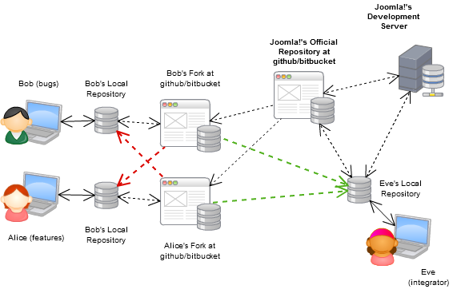
Basic Work Flow
Notes:
Contributors can step in immediately, since:
All they would need is to fork the project from the official repository in a service.
No need for them build patches, once they are finished, they can just ask others to pull from their repository.
A more open development process for everyone.
Contributors can team up and handle their own merging, thus giving greater quality contributions in the end.
Less work for integrators (merging branches is trivial (under 5 minutes))
Contributors can have their own branches without affecting others' (but being able to share them if necessary).
...
However, there are some potential problems:
Grasping the distributed model represents somewhat of a learning curve (unbiasing oneself from CVS/SVN is a general recommendation).
Everyone must be willing to adopt the tool

Slide 7

DEMO
Notes:
Create blogification project on github
Complete the setup
Add some files and push

